Slide 1
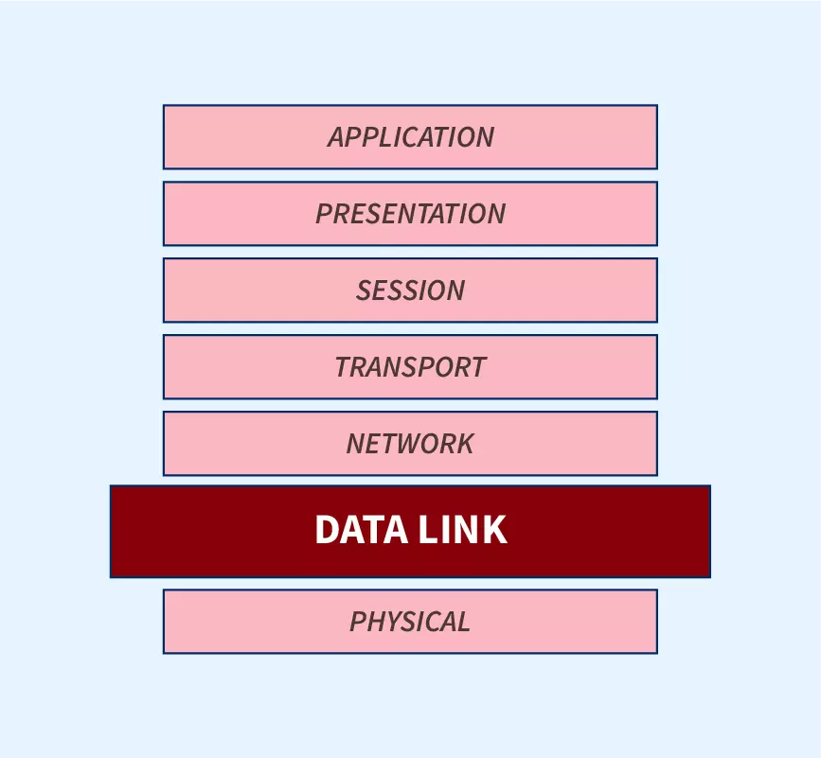
Lec -16
Data link Layer

Slide 2
What is data link layer ?
The data link layer is Layer 2 in the Open Systems Interconnection (OSI) architecture model for a set of telecommunication protocols.
The data link layer is the protocol layer in a program that handles the moving of data into and out of a physical link in a network.
It is responsible for the node-to - node delivery of data and frame are used in it . Its major role is to ensure error-free transmission of information. DLL is also responsible to encode, decode and organize the outgoing and incoming data.

Slide 3
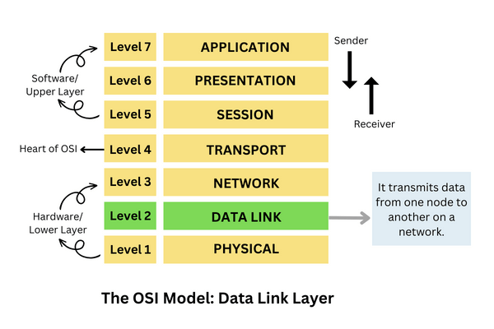
The main position of Data link Layer in OSI Model .

Slide 4
Sublayers in data link layer.
Sub-layers of Data Link Layer:
The data link layer is further divided into two sub-layers, which are as follows:
Logical Link Control (LLC):-
This sublayer of the data link layer deals with multiplexing, the flow of data among applications and other services, and LLC is responsible for providing error messages and acknowledgments as well.
Media Access Control (MAC): -
MAC sublayer manages the device’s interaction, responsible for addressing frames, and also controls physical media access.

Slide 5
What are design issues of Data link Layer ?
Data Link Layer Design Issues.
Services Provided to the Network Layer
Framing
Error Control
Flow Control

Slide 6
Services provided to the network layer – The data link layer act as a service interface to the network layer. The principle service is transferring data from network layer on sending machine to the network layer on destination machine. This transfer also takes place via DLL (Data link-layer).
Error control – Error control is done to prevent duplication of frames. The errors introduced during transmission from source to destination machines must be detected and corrected at the destination machine.

Slide 7
Framing .
The data link layer needs to pack bits into frames, so that each frame is distinguishable from another. Our postal system practices a type of framing. The simple act of inserting a letter into an envelope separates one piece of information from another; the envelope serves as the delimiter.
The packet received from the Network layer is known as a frame in the Data link layer. At the sender’s side, DLL receives packets from the Network layer and divides them into small frames, then, sends each frame bit-by-bit to the physical layer. It also attaches some special bits (for error control and addressing) at the header and end of the frame. At the receiver’s end, DLL takes bits from the Physical layer organizes them into the frame, and sends them to the Network layer.

Slide 8
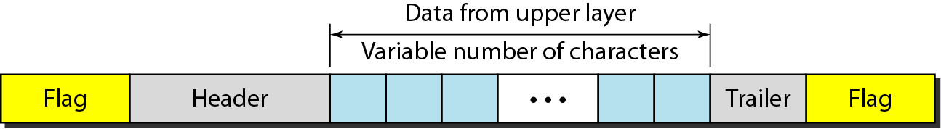
Types of Framing .
Fixed Size Framing –
Variable Size Framing--- Character oriented protocols and Bit oriented Protocols.
A frame in a character-oriented protocol .

Slide 9
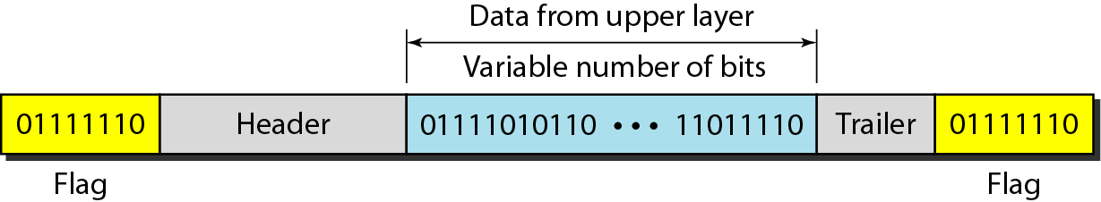
A frame in a bit-oriented protocol .

Slide 10
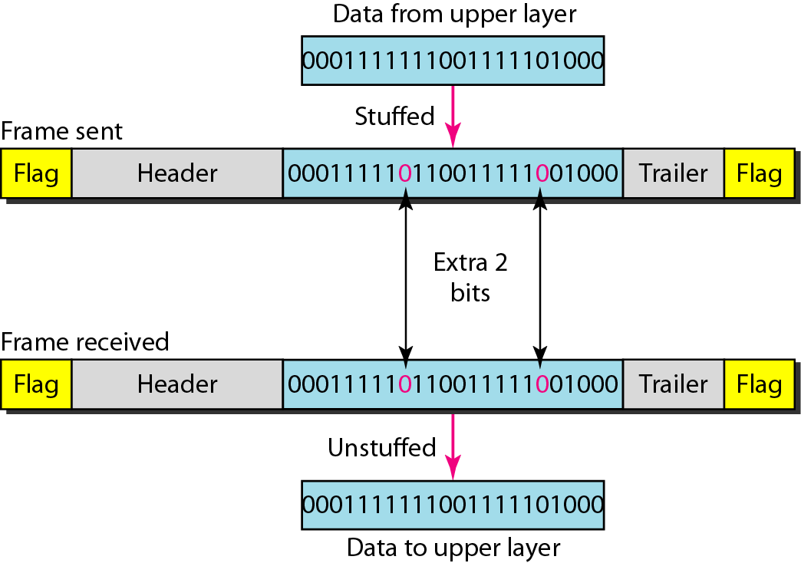
Bit stuffing and unstuffing .

Slide 11
Bit stuffing and unstuffing.
Byte stuffing is the process of adding 1 extra byte whenever there is a flag or escape character in the text.

Slide 12
FLOW AND ERROR CONTROL.
Flow control refers to a set of procedures used to restrict the amount of data that the sender can send before waiting for acknowledgment.
If the receiver’s receiving speed is lower than the sender’s sending speed, then this can lead to an overflow in the receiver’s buffer and some frames may get lost. So, it’s the responsibility of DLL to synchronize the sender’s and receiver’s speeds and establish flow control between them.
Flow control tells the sender how much data should be sent to the receiver so that it is not lost. This mechanism makes the sender wait for an acknowledgment before sending the next data. There are two ways to control the flow of data.

Slide 13
Stop and Wait Protocol .
It is the simplest flow control method. In this, the sender will send one frame at a time to the receiver. Until then, the sender will stop and wait for the acknowledgment from the receiver. When the sender gets the acknowledgment then it will send the next data packet to the receiver and wait for the acknowledgment again and this process will continue. This can be understood by the diagram below.

Slide 14
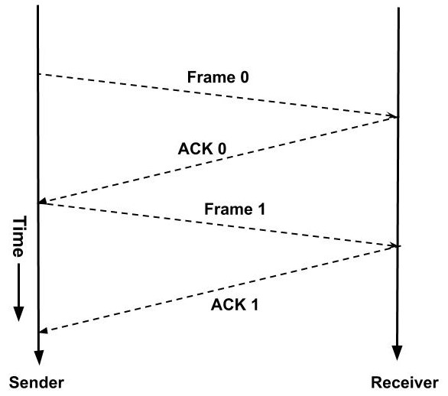
Stop and wait protocol.

Slide 15
Sliding Window Protocol .
In sliding window protocol we will utilize this time. We will change this waiting time into transmission time.
A window is a buffer where we store the frames. Each frame in a window is numbered. If the window size is n then the frames are numbered from the number 0 to n-1. A sender can send n frames at a time. When the receiver sends the acknowledgment of the frame then we need not store that frame in our window as it has already been received by the receiver.

Slide 16
Stop and Wait Protocol .
So, the window in the sender side slides to the next frame and this window will now contain a new frame along with all the previous unacknowledged frames of the window.

Slide 17
Sliding Window Protocol Steps.
At any instance of time window will only contain the unacknowledged frames. This can be understood with the example below:
Suppose the size of the window is 4. So, the frames would be numbered as 0,1,2,3,0,1,2,3,0,… so on.
Initially, the frames in the window are 0,1,2, 3. Now, the sender starts transmitting the frames. The first frame is sent, then second and so on.
When the receiver receives the first frame i.e. frame 0. Then it sends an acknowledgment.
3. When the acknowledgment is received by the sender then it knows that the first frame has been received by the receiver and it need not keep its record. So, the window slides to the next frame.
4.The new window contains the frame 1, 2, 3, 0. In this way, the window slides hence the name sliding window protocol.

Slide 18
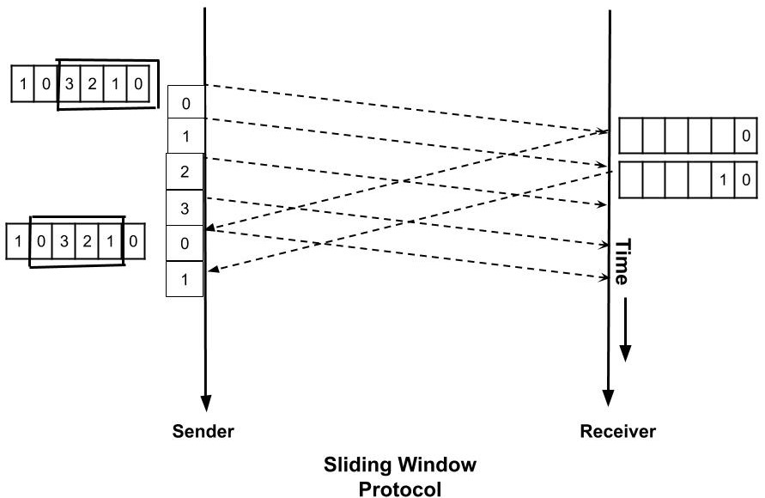
Sliding the window protocols.

Slide 19
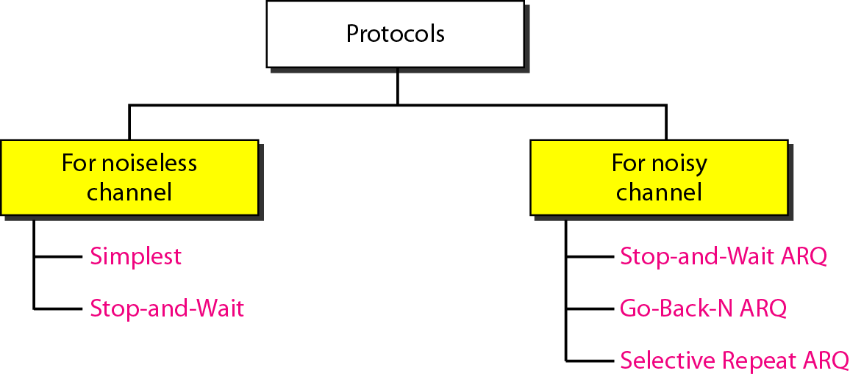
Taxonomy of protocols .

Slide 20
NOISELESS CHANNELS.
Let us first assume we have an ideal channel in which no frames are lost, duplicated, or corrupted. We introduce two protocols for this type of channel.
1.SimplestProtocol 2. Stop-and-Wait Protocol

Slide 21
Simplest Protocol .
It is a type of protocol in which No flow and Error Control is performed . The simplest protocol is a unidirectional protocol in which the data frames are traveling in only one direction from the sender to the receiver. Since the simplest protocol is unidirectional, there is no acknowledgment (ACK).

Slide 22
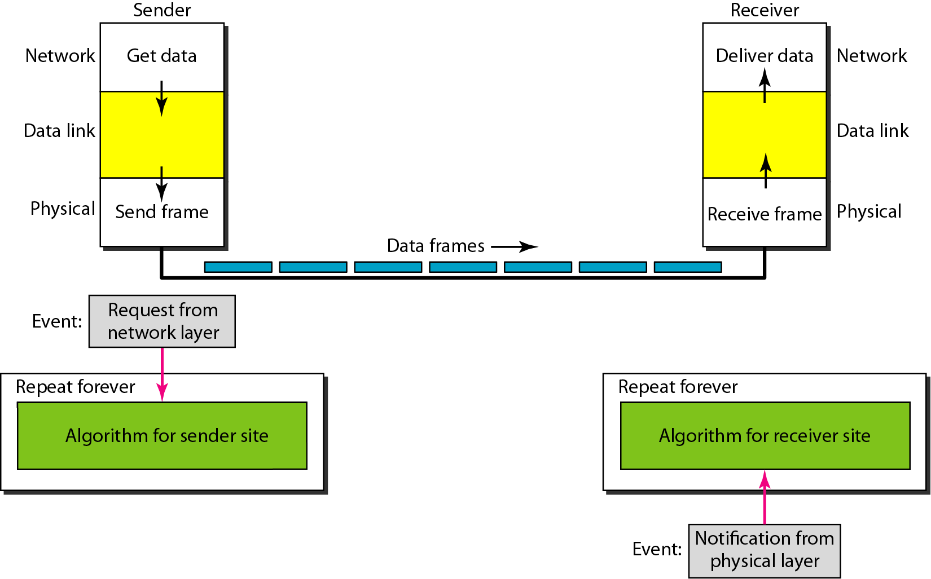
The design of the simplest protocol with no flow or error control.

Slide 23
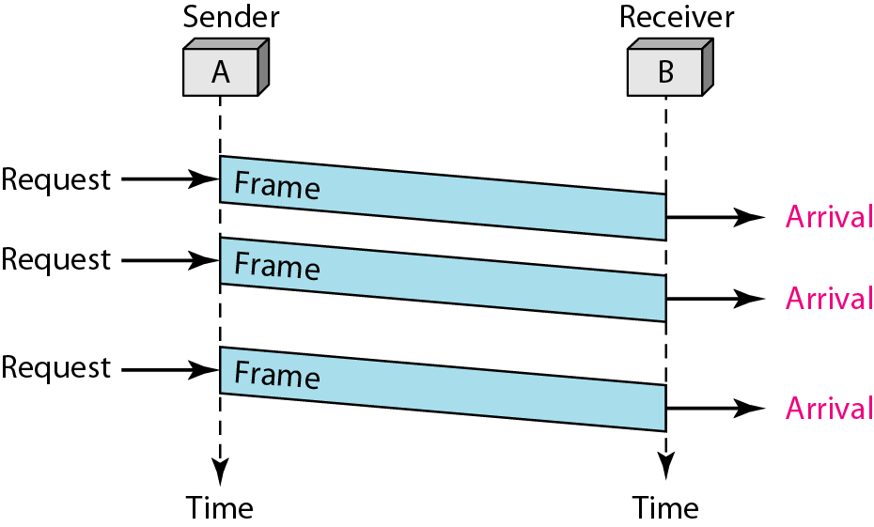
Flow diagram for Simplest .

Slide 24
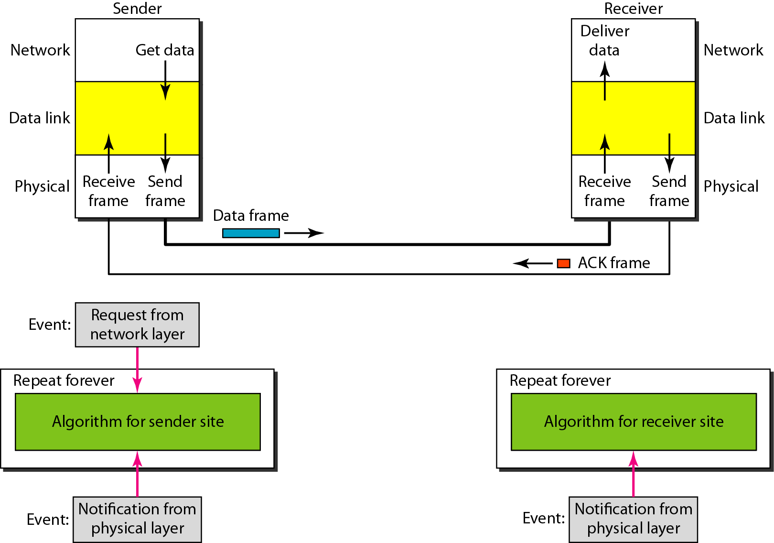
Stop-and-Wait Protocol .
Sender sends one frame, stops until it gets confirmation from receiver.

Slide 25
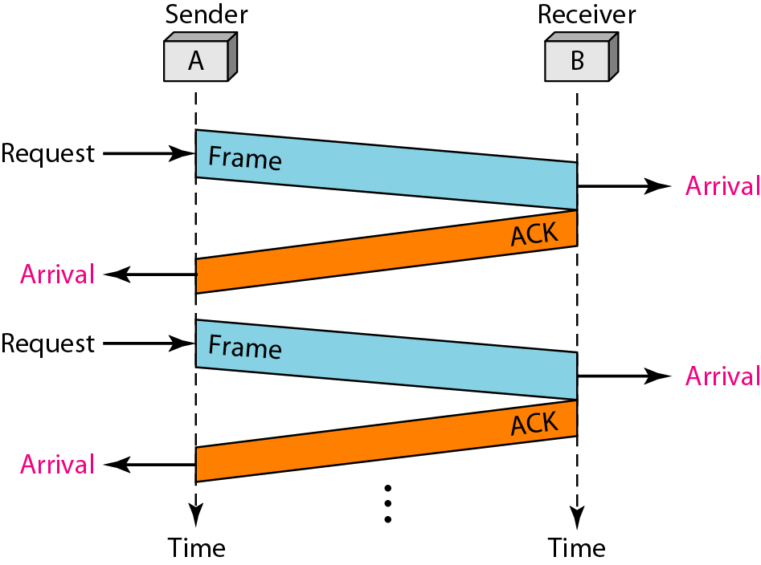
Flow diagram for Stop and Wait .

Slide 26

Note
In Stop-and-Wait ARQ, the acknowledgment number is 0 if sequence number is 1 and acknowledgment number is 1 if sequence number is 0

Slide 27
Note
In Stop-and-Wait ARQ, the acknowledgment number is 0 if sequence number is 1 and acknowledgment number is 1 if sequence number is 0

Slide 28
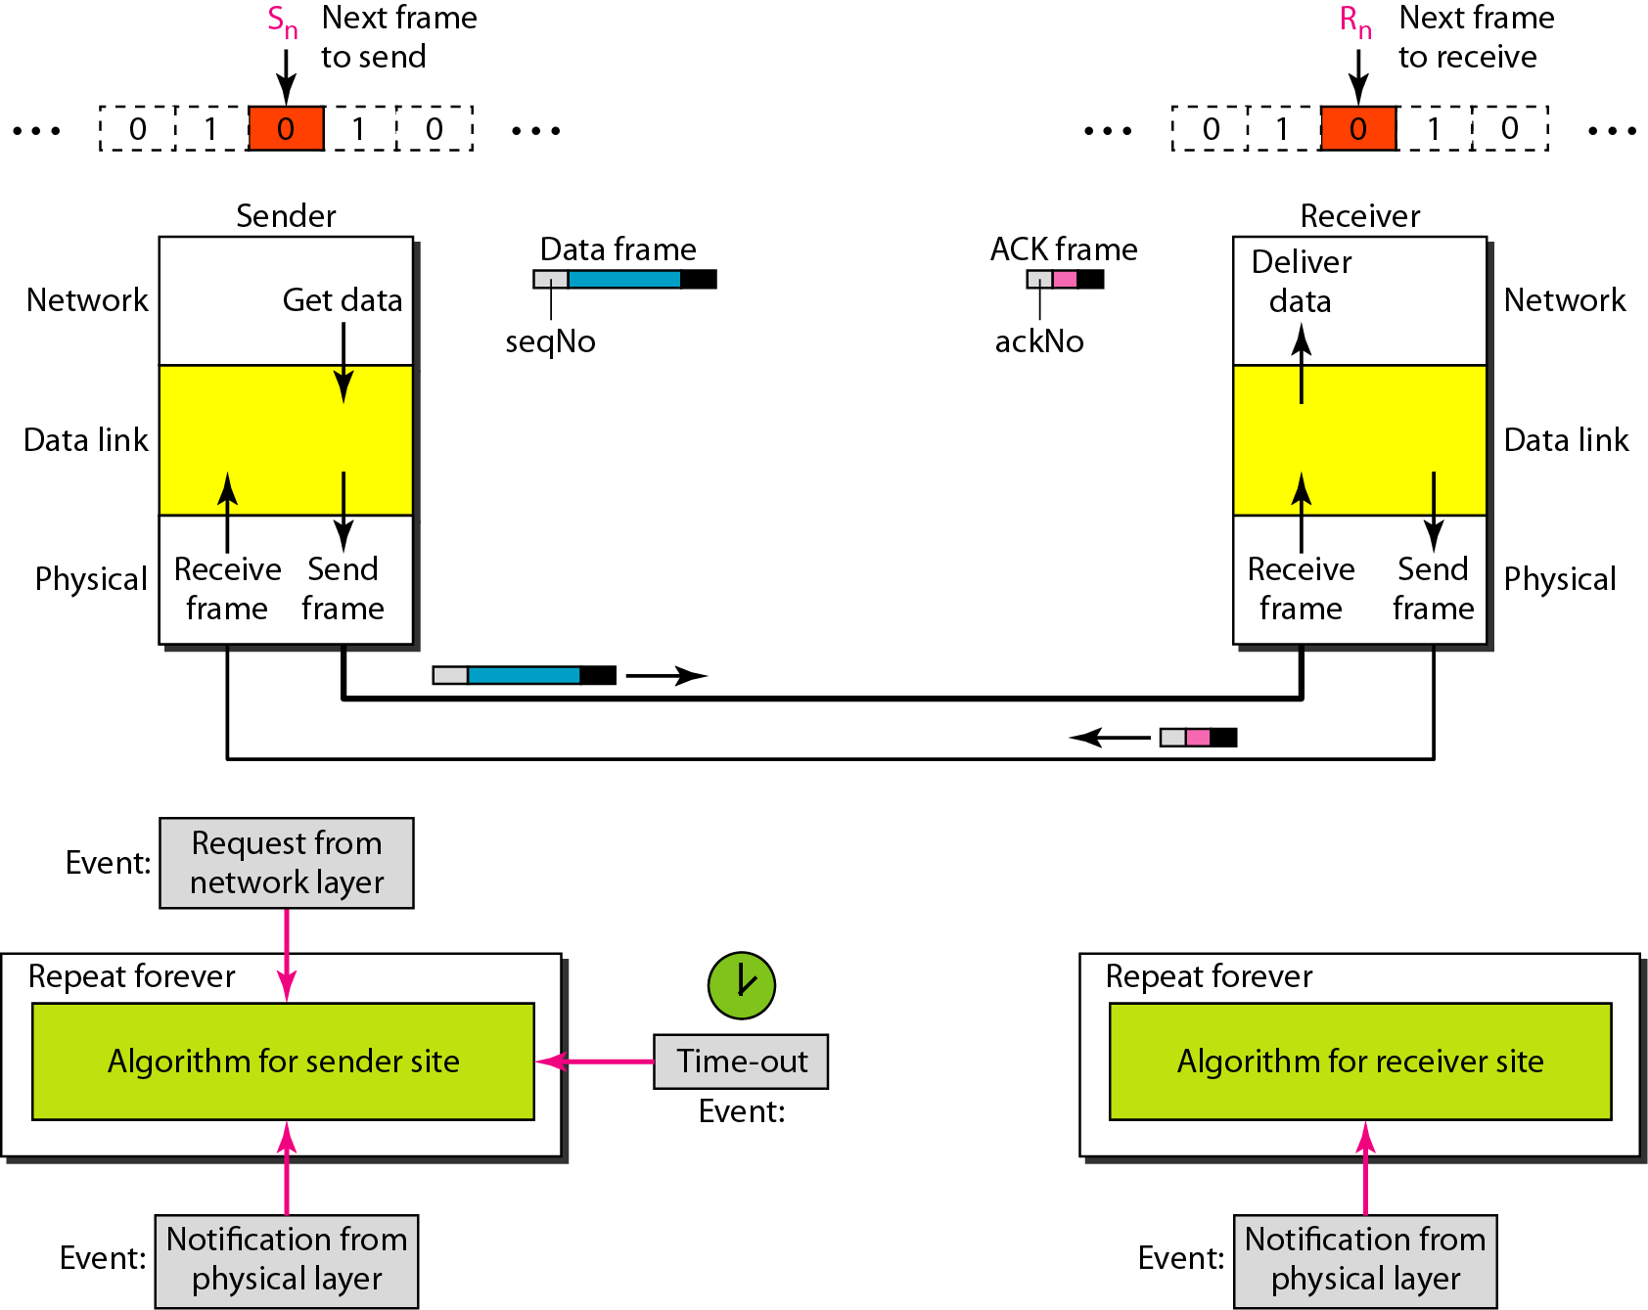

Slide 29
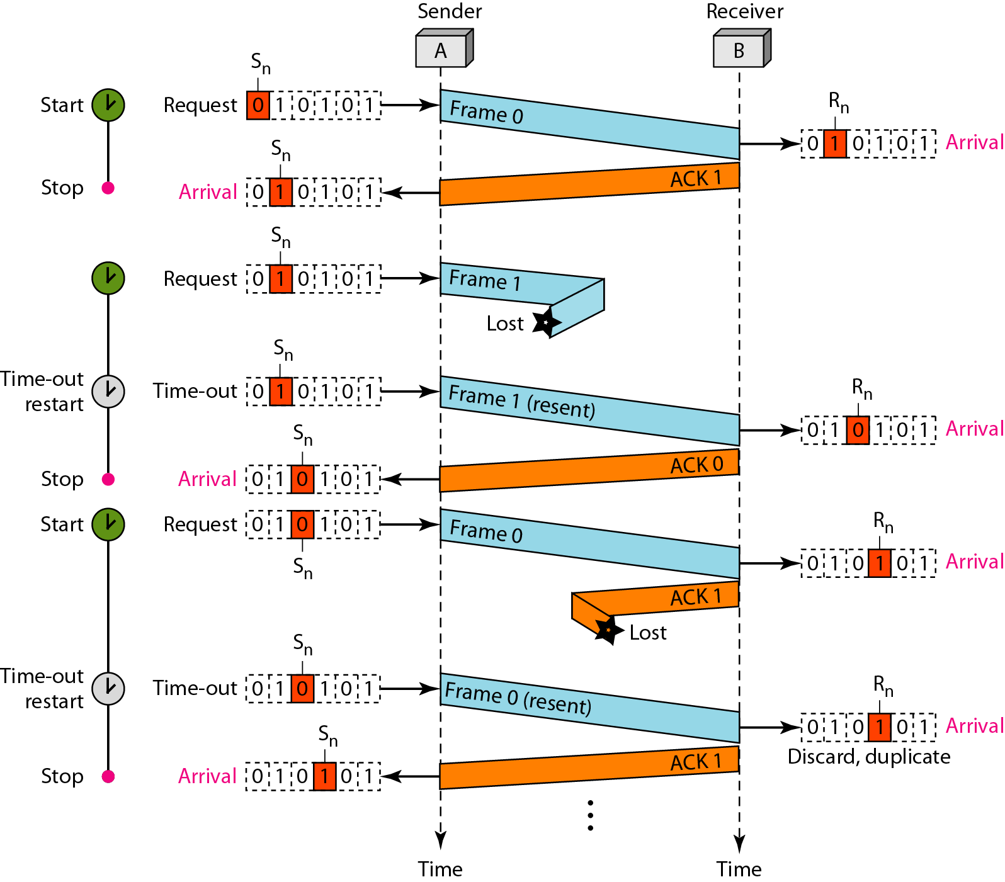

Slide 30
Disadvantage Stop-and-Wait ARQ Protocol
Inefficient---if channel is thick and long
Thick means high bandwidth
Long means roundtrip delay
Product of both is bandwidth delay.
Bandwidth delay is number of bits we can send while waiting for news from receiver.

Slide 31
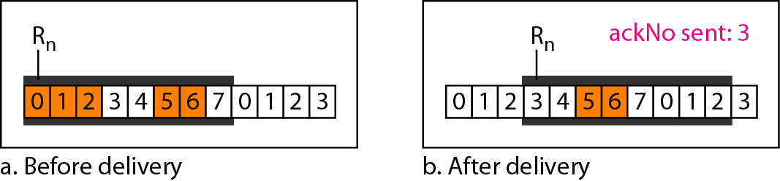

Slide 32
Error Detection and Correction in Data link Layer .
Data-link layer uses error control techniques to ensure that frames, i.e. bit streams of data, are transmitted from the source to the destination with a certain extent of accuracy.
Networks must be able to transfer data from one device to another with complete accuracy. Data can be corrupted during transmission.
For reliable communication, errors must be detected and corrected.
Error detection and correction are implemented either at the data link layer or the transport layer of the OSI model.

Slide 33
Errors .
It is see that bits are transmitted over the computer network, they are subject to get corrupted due to interference and network problems. The corrupted bits leads to spurious data being received by the destination and are called errors.
There are different types of errors .

Slide 34
Different types of errors.

Slide 35
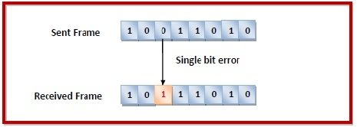
Single-bit error .
Single bit error − In the received frame, only one bit has been corrupted, i.e. either changed from 0 to 1 or from 1 to 0.

Slide 36
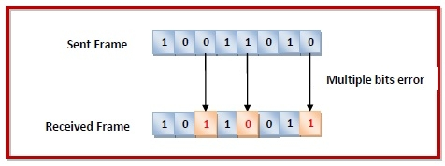
Multiple bits error .
Multiple bits error − In the received frame, more than one bits are corrupted.

Slide 37
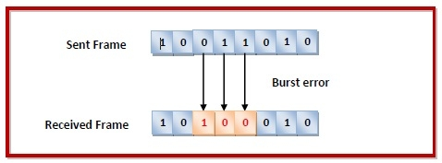
Burst error
The term burst error means that two or more bits in the data unit have changed from 1 to 0 or from 0 to 1. Burst errors does not necessarily mean that the errors occur in consecutive bits, the length of the burst is measured from the first corrupted bit to the last corrupted bit. Some bits in between may not have been corrupted.

Slide 38
Brust error.

Slide 39
Error Control.
Error control can be done in two ways
Error detection − Error detection involves checking whether any error has occurred or not. The number of error bits and the type of error does not matter.
Error correction − Error correction involves ascertaining the exact number of bits that has been corrupted and the location of the corrupted bits.

Slide 40
Error detection .
Error detection means to decide whether the received data is correct or not without having a copy of the original message. Error detection uses the concept of redundancy, which means adding extra bits for detecting errors at the destination.

Slide 41
Four types of redundancy checks are used in data communications .

Slide 42
Vertical Redundancy Check VRC.

Slide 43
LCR Longitudinal Redundancy Check increases the likelihood of detecting burst errors.
If two bits in one data units are damaged and two bits in exactly the same positions in another data unit are also damaged, the LRC checker will not detect an error.

Slide 44
Longitudinal Redundancy Check LRC .

Slide 45
Cyclic Redundancy Check (CRC) .
Cyclic Redundancy Check (CRC) involves binary division of the data bits being sent by a predetermined divisor agreed upon by the communicating system. The divisor is generated using polynomials.
Here, the sender performs binary division of the data segment by the divisor. It then appends the remainder called CRC bits to the end of the data segment. This makes the resulting data unit exactly divisible by the divisor.
The receiver divides the incoming data unit by the divisor. If there is no remainder, the data unit is assumed to be correct and is accepted. Otherwise, it is understood that the data is corrupted and is therefore rejected.

Slide 46
CRC

Slide 47
Binary Division

Slide 48
Polynomial .

Slide 49
Polynomial and Divisor .

Slide 50
Checksum .
In this error detection scheme, the following procedure is applied.
Data is divided into fixed sized frames or segments.
The sender adds the segments using 1’s complement arithmetic to get the sum. It then complements the sum to get the checksum and sends it along with the data frames.
The receiver adds the incoming segments along with the checksum using 1’s complement arithmetic to get the sum and then complements it.
If the result is zero, the received frames are accepted; otherwise, they are discarded.

Slide 51
Checksum
The checksum detects all errors involving an odd number of bits.
It detects most errors involving an even number of bits.
If one or more bits of a segment are damaged and the corresponding bit or bits of opposite value in a second segment are also damaged, the sums of those columns will not change and the receiver will not detect a problem.

Slide 52
Checksum .

Slide 53
Hamming code
Hamming code is an error correction system that can detect and correct errors when data is stored or transmitted. It requires adding additional parity bits with the data.
Hamming code uses a block parity mechanism. The data is divided into blocks, and parity is added to the block. Hamming code can correct single-bit errors and detect the presence of two-bit errors in a data block.

Slide 54
In the hamming code redundant bits are placed .
Determining the position of redundant bits – These redundancy bits are placed at positions that correspond to the power of 2.
As in the above example:
The number of data bits = 7
The number of redundant bits = 4
The total number of bits = 11
The redundant bits are placed at positions corresponding to power of 2- 1, 2, 4, and 8

Slide 56
Hamming Code

Slide 58
Example of hamming code.

Slide 59
Single-bit error .

Slide 60
Error
Detection

Slide 61
Devices of data link layer.
Bridges:
A bridge is a type of computer network device that provides interconnection with other networks that use the same protocol, connecting two different networks together and providing communication between them.
Switch:
A network switch is a multiport network bridge that uses MAC addresses to forward data at the data link layer (layer 2) of the OSI model. Some switches can also forward data at the network layer (layer 3) by additionally incorporating routing functionality. Such switches are commonly known as layer-3 switches or multilayer switches.

Slide 62
Network Interface Card
Network Interface Card: -
Network interface card is an electronic device that is mounted on ROM of the com that connects a computer to a computer network, usually a LAN. Most modern computers support an internal network interface controller embedded in the motherboard directly rather than provided as an external component.
Working of switch .
A network switch connects devices in a network to each other, enabling them to talk by exchanging data packets. Switches can be hardware devices that manage physical networks or software-based virtual devices.

Slide 63
Working of switch .

Slide 64


